Slide 1
"Exploring the Relationship Between Mental Health Emergencies and Suicide Rates"
Vineet Mehta

Slide 2
Introduction
The rise in mental health issues and suicide rates in the U.S. has become a major public health concern. Understanding the relationship between these two factors is critical for developing effective interventions.
Objectives:
Analyze trends in mental health ED visits and suicide rates.
Assess the correlation between the two variables.
Evaluate predictive power using linear regression models.

Slide 3
Data Overview
Mental Health ED Visits (2008-2017):
Data Source: SHIP records
Represents total annual ED visits related to mental health.
Suicide Rates (2000-Present):
Data Source: National datasets
Includes annual age-adjusted suicide rates per 100,000 people in the U.S.

Slide 4

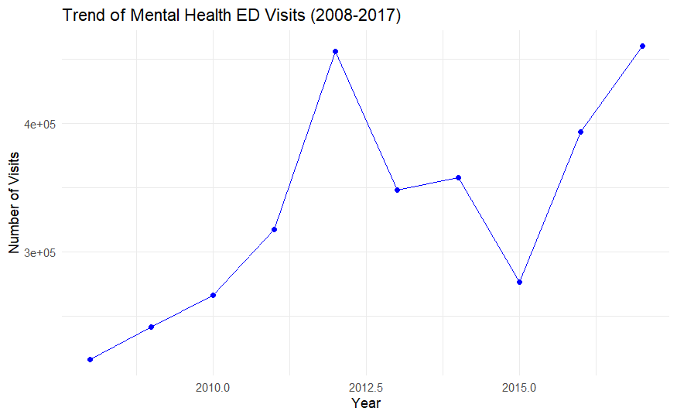
Trend Analysis of Suicide Rates
Suicide rates exhibit fluctuations from 2000 to the present, with some periods of increase followed by decreases.
Peaks may align with economic downturns or societal challenges, while declines could reflect successful prevention strategies

Slide 5
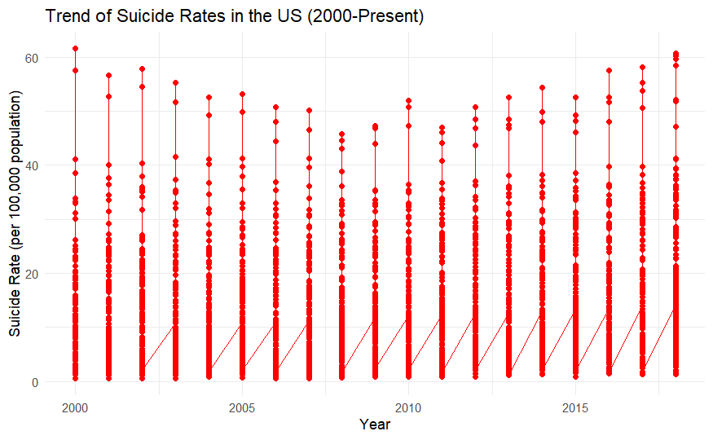
Trend Analysis of Suicide Rates
Suicide rates exhibit fluctuations from 2000 to the present, with some periods of increase followed by decreases.
Peaks may align with economic downturns or societal challenges, while declines could reflect successful prevention strategies.

Slide 6

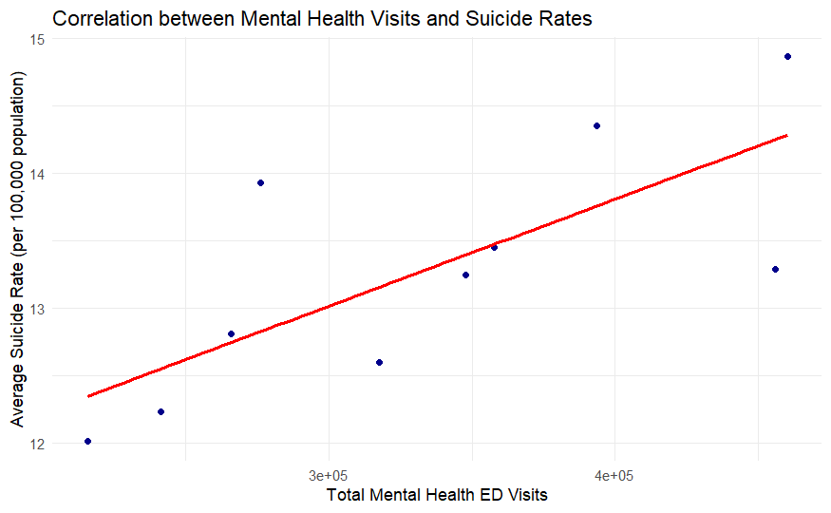



Correlation between Mental Health Visits and Suicide Rates
Points clustered upward along the linear fit line suggest that as mental health visits increase, suicide rates also tend to increase.

Slide 7
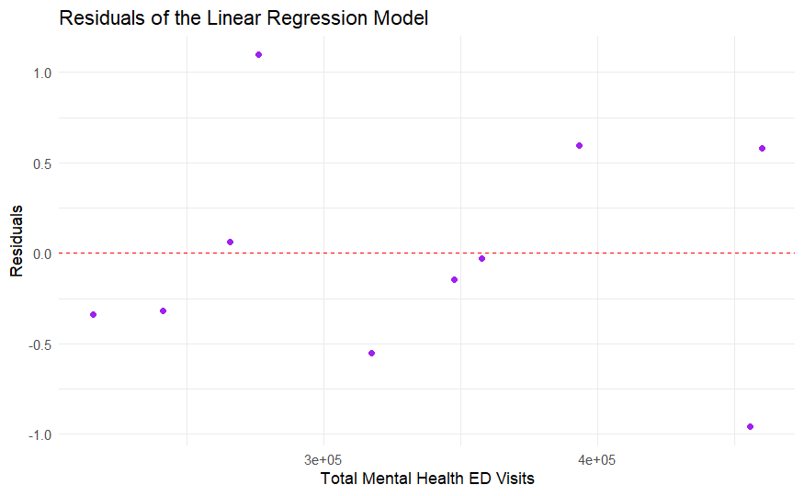
Linear regression model predicting suicide rates based on mental health ED visits
While the linear model provides a general understanding, the presence of outliers or variability in the residuals indicates that other factors (e.g., economic downturns, policy changes, social factors) could also play a significant role in influencing suicide rates.

Slide 8
Conclusion
Mental Health ED Visits
Suicide Rates
Correlation
Predictive Power

Slide 9
Broader Implications
Policy Implications
Future Research
Public Awareness & Education

Slide 10
Final Thought
Call to Action: Mental health and suicide prevention require a holistic approach that includes policy changes, community engagement, and continuous research. By identifying the complex factors that drive both mental health crises and suicides, public health stakeholders can design more effective interventions aimed at improving overall mental wellness.

Slide 11
Thank You

